Slide 1
Report : Lidar Assisted Controller
Date: 14/10/25
Supervisor: prof. David Schlipf
Group members: Midhun Kanichattu Venu,Hesham Mahmoud

Slide 2
List of contents
Bladed control interface (pre-v4.4)
Swap array communication
Handshaking and synchronization
Data exchange flow
Midhun Kanichattu Venu 770588

Slide 3
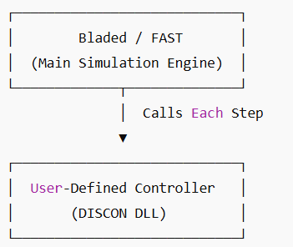
Bladed Control Interfaces
Who calls whom
Bladed is the main simulation engine
Calls the User-Defined Controller (DLL or EXE) each timestep
Controller reads inputs → computes → returns outputs
How Signal Transfer Works
DLL Case: uses array avrSWAP in memory (faster, direct)
EXE Case: uses shared binary file discon.swp
Each record = one signal (4 bytes)
Record 1 used for handshaking (0 = wait, 1 = ready, -1 = end)
Midhun Kanichattu Venu 770588

Slide 4
Handshake Process (Record 1)
Bladed Simulation
Flow:
Controller writes 0 → ready
Bladed sets 1 → data ready
Controller reads, writes outputs, sets 0 again
Simulation continues
Csharp
AvrSwap Array
User Controller Dll
Output
Bladed
Midhun Kanichattu Venu 770588

Slide 5
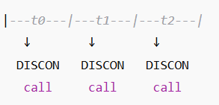
Array Data Exchange
Record | Direction | Description | Units
2 | In | Current time | s
4 | In | Blade 1 pitch angle | rad
20 | In | Generator speed | rad/s
45 | Out | Commanded pitch | rad
47 | Out | Commanded torque | Nm
Execution Timing
Midhun Kanichattu Venu 770588
Midhun Kanichattu Venu 770588

Slide 6
Link to OpenFAST
OpenFAST runs the full turbine simulation.
Calls ServoDyn, which manages control interfaces.
ServoDyn uses the Bladed Legacy Interface (BLI) to link with control DLLs.
Case 1: ServoDyn → ROSCO.dll (standard feedback control).
Case 2: ServoDyn → Wrapper.dll → calls LDP.dll, FFP.dll, and ROSCO.dll.
Enables combined feedforward, feedback, and lidar-based control.
Midhun Kanichattu Venu 770588

Slide 7
DLL Comunication
Lidar Simulator provides the following signals to the LDP.DLL in the swayArray
Table with record and description
LDP.DLL provides the following signals to the FFP.DLL in the swayArray
Table with record and description
FFP.DLL provides the following signals to the Rosco.DLL in the swayArray
Table with record and description
Graph
OpenFAST Lidar Simuator
LDP
FFP
Rosco
Midhun Kanichattu Venu 770588

Slide 8
Git and Github
Introduction to Git & GitHub
Git: A version control system to track changes in code/projects
GitHub: A cloud platform to store, share, and collaborate on Git repositories
Helps manage versions, collaborate with teams, and keep history of all changes
Common Operations: Clone, Commit, Push, Pull
Clone → Copy repository from GitHub to local machine
→ Command: git clone <repository_URL>
Commit → Save changes locally as a snapshot
→ Commands: git add git commit -m "Describe your change"
Midhun Kanichattu Venu 770588

Slide 9
Git and Github
Push → Upload local commits to GitHub
→ Command: git push origin main
Pull → Fetch and merge latest updates from GitHub
→ Command: git pull origin main
Getting Latest Files from GitHub:
1. git clone <repo> → First-time download
2. git fetch → Check for updates
3. git pull → Download & merge changes
Midhun Kanichattu Venu 770588

Slide 10
Git And Github
Sharing Your Code:
1. git add .
2. git commit -m "Message"
3. git push origin main
Team Collaboration:
1Create a branch → git checkout -b new-feature
2 Fork repos to contribute to others’ projects
3 Submit Pull Requests for code review
Midhun Kanichattu Venu 770588

Slide 11
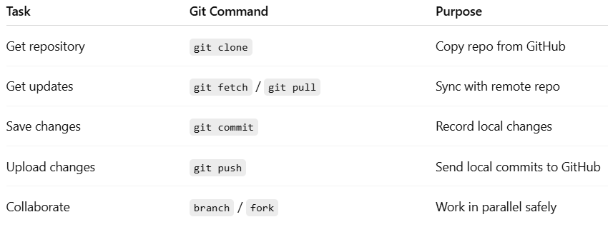
Git And Github
Midhun Kanichattu Venu 770588

Slide 12
Bibliography – Lidar Assisted controller
Hansen, M. Aerodynamics of Wind Turbines, 3rd Ed., Routledge, 2015.
Ingram, G. Wind Turbine Blade Element Momentum Theory, 2011.
Bossanyi, E. Controller Design for Variable-Speed Wind Turbines, Wind Engineering, 2000
Midhun Kanichattu Venu 770588

